Slide 1

2024년도 1학기
인공지능
Artificial Intelligence

Slide 2
데이터시각화 - Seaborn
06
Seaborn는 무엇인가?
Seaborn 설치
Seaborn Charts
Seaborn 데이터 분석을 위한 차트

Slide 3
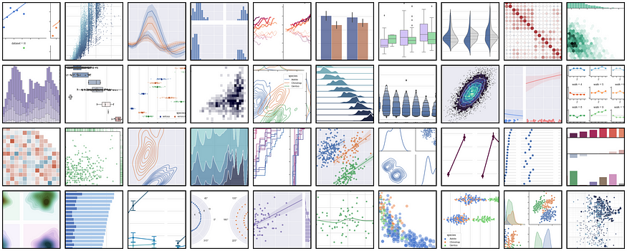
Seaborn는 무엇인가?
Seaborn is a Python data visualization library based on matplotlib
It provides a high-level interface for drawing attractive and informative statistical graphics
Notes:
Seaborn은 matplotlib를 기반으로 한 Python 데이터 시각화 라이브러리입니다.
매력적이고 유익한 통계 그래픽을 그리기 위한 높은 수준의 인터페이스를 제공합니다.

Slide 4
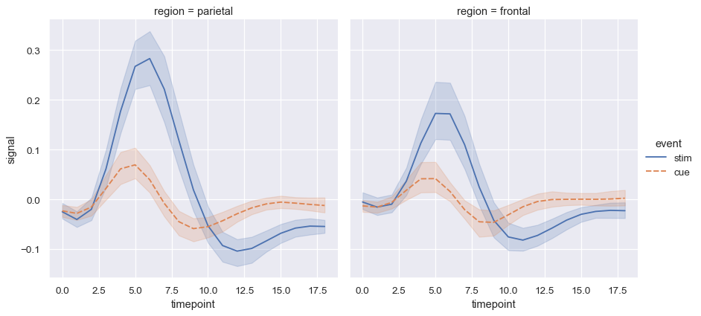
Seaborn Features
Statistical Estimation
Average of values
Notes:
값의 평균

Slide 5
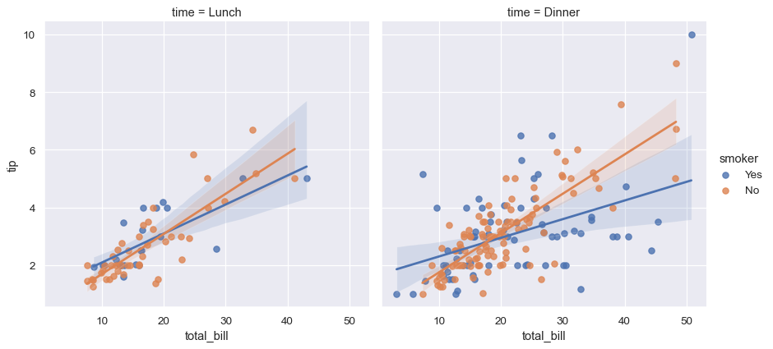
Seaborn Features
Statistical Estimation
Linear Regression Model
Notes:
선형 회귀 모델

Slide 6
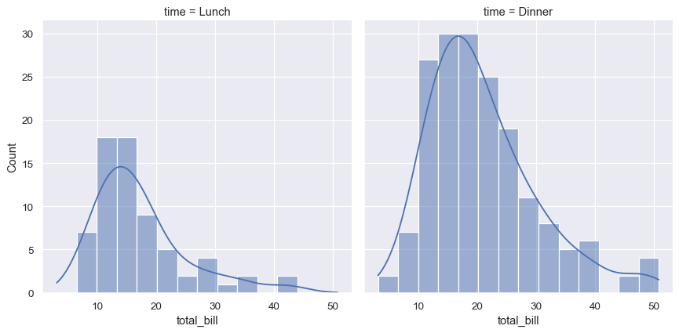
Seaborn Features
Distributional representations
Histograms or kernel density estimation
Notes:
히스토그램 및 밀도

Slide 7
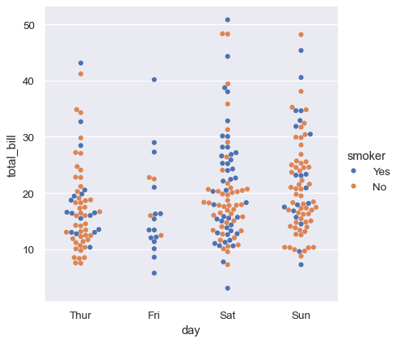
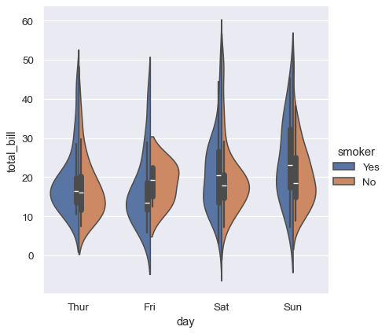
Seaborn Features
Plots for categorical data
Swarm plot, kernel density estimation for underlying distribution
Notes:
Swarm plot과 swarm plot의 밀도를 보여주는 기능

Slide 8
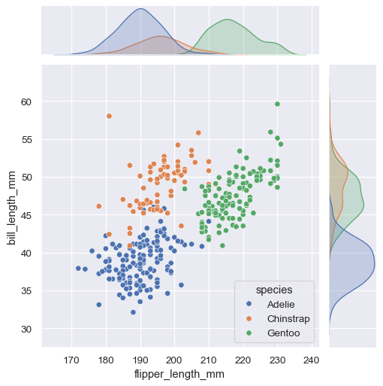
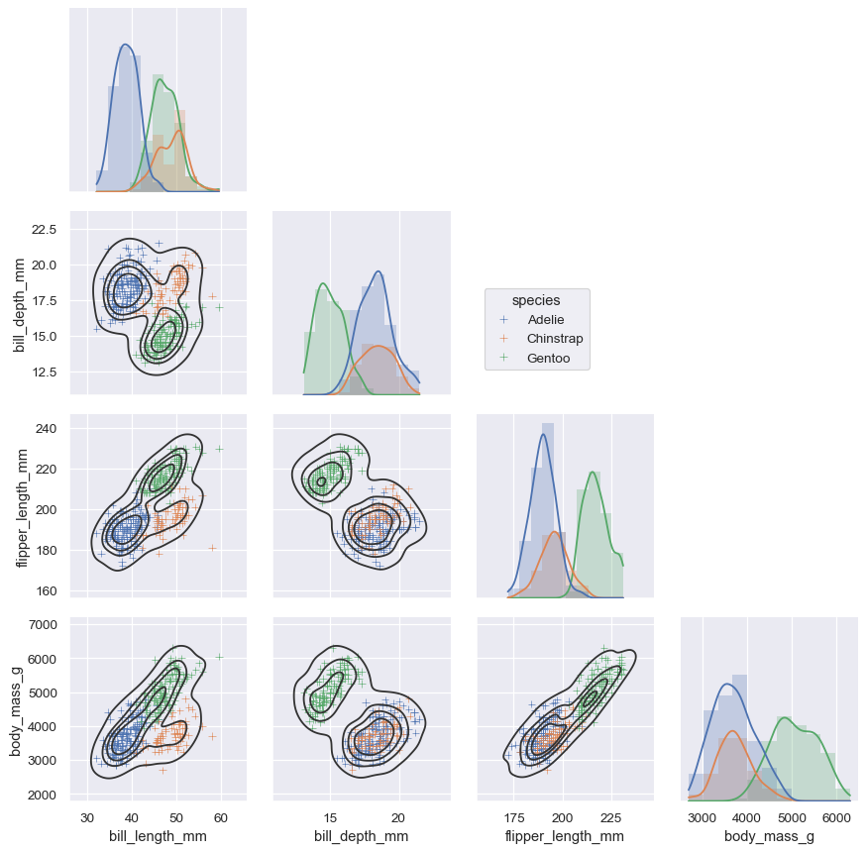
Seaborn Features
Multivariate views on complex datasets
Easy coding for complex graphs
Notes:
복잡한 그래프도 쉽게 코딩할 수 있음

Slide 9
Plotly 설치
Jupyter Notebook을 실행합니다.
명령 프롬프트(CMD)를 실행하고 다음 명령어를 사용합니다.
pip install seaborn
다른 라이브러리 또한 설치해야 합니다.
Numpy, scipy, matplotly, pandas
plotly 라이브러리 버전을 확인합니다.
import seaborn //Importing seaborn library
print(seaborn.__version__) //Printing library version

Slide 10
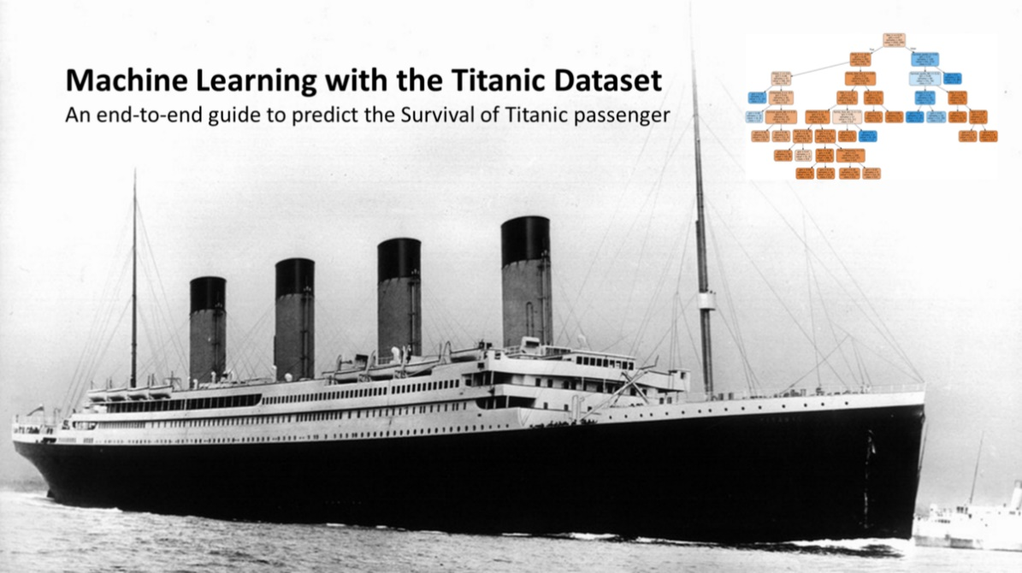
Data
Dataset
titanic.csv
import pandas as pd
titanic_df = pd.read_csv("D:/titanic.csv")

Slide 11
Data
info()
Provides essential details about your dataset
titanic_df.info()
<class 'pandas.core.frame.DataFrame'>
RangeIndex: 895 entries, 0 to 894
Data columns (total 12 columns):
PassengerId 895 non-null int64
Survived 895 non-null int64
Pclass 895 non-null int64
Name 895 non-null object
sex 895 non-null object
Age 718 non-null float64
SibSp 895 non-null int64
Parch 895 non-null int64
Ticket 895 non-null object
Fare 884 non-null float64
Cabin 204 non-null object
Embarked 893 non-null object
dtypes: float64(2), int64(5), object(5)
memory usage: 66.5+ KB

Slide 12
Seaborn Charts
C

Slide 13
Count Plot
countplot()
Show the counts of observations in each category using bars
data – dataset for plotting
x, y – inputs for plotting data
#importing library
import seaborn as sns
import matplotlib.pyplot as plt
#importing dataset
titanic = sns.load_dataset("titanic")
#plotting chart
sns.countplot(x=‘sex', data=titanic)
plt.show()

Slide 14
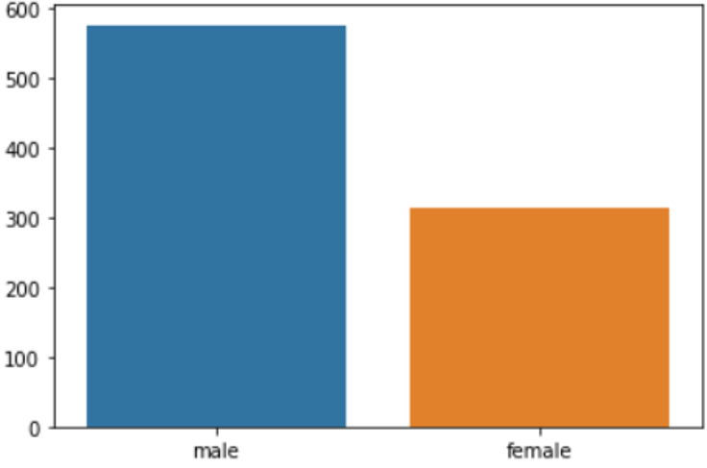
Count Plot
countplot()
Show the counts of observations in each category using bars
data – dataset for plotting
x, y – inputs for plotting data

Slide 15
Count Plot
countplot()
hue - visualize the data of different categories in one plot
palette - colors to use for the different levels of the hue variable
#importing library
import seaborn as sns
import matplotlib.pyplot as plt
#importing dataset
titanic = sns.load_dataset("titanic")
#plotting chart
sns.countplot(x=‘sex',
data=titanic,
hue="embark_town",
palette=“Blues")
plt.show()
Notes:
Hue - 하나의 plot에서 다양한 카테고리의 데이터를 시각화 (Palette를 적용할 변수를 설정)
Palette - 색조 변수의 다양한 수준에 사용할 색상

Slide 16
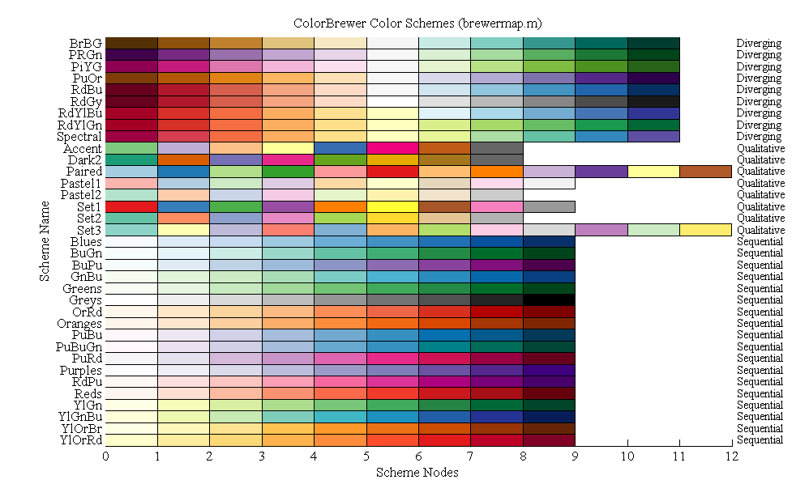
Count Plot
Seaborn palette colors

Slide 17
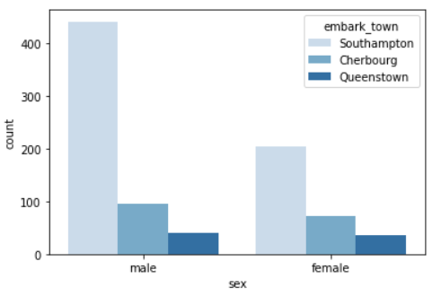
Count Plot
countplot()
hue - visualize the data of different categories in one plot
palette - colors to use for the different levels of the hue variable
Notes:
Hue - 하나의 plot에서 다양한 카테고리의 데이터를 시각화 (Palette를 적용할 변수를 설정)
Palette - 색조 변수의 다양한 수준에 사용할 색상
embark_town 승선지

Slide 18
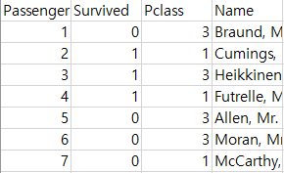
Count Plot
countplot()
You can add options like title, label names and legend location
#importing library
import seaborn as sns
import matplotlib.pyplot as plt
#importing dataset
titanic = sns.load_dataset("titanic")
#plotting chart
sns.countplot(x='pclass', data=titanic, hue='survived', palette="husl")
plt.title("Survived by Passanger Class")
plt.xlabel("Passenger Classes")
plt.ylabel("Number of Passengers")
plt.legend(loc='best')
plt.show()
x축이 plcass이고 hue는 x축 안에서 survived (생존자)를 카운팅하는 것
Palette의 속성값을 15페이지에 있는 값으로 변경해보자
Notes:
제목, 라벨 이름, 범례 위치와 같은 옵션 추가 가능

Slide 19
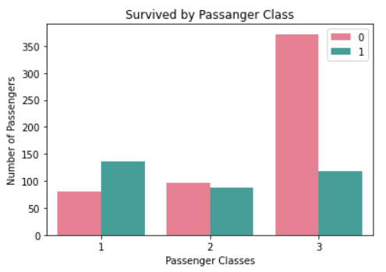
Count Plot
countplot()
plt.legend(loc='best’)
upper left, upper right, lower left, lower right, etc (Default value ‘best’)
loc의 값을 upper right, upper left, lower left, lower right로 변경해보자
Notes:
plt.legend 범례의 위치 지정

Slide 20
Bar Plot
barplot()
Unlike count plot, bar plots must include x and y axis variables
#importing library
import seaborn as sns
import matplotlib.pyplot as plt
#importing dataset
titanic = sns.load_dataset("titanic")
#plotting chart
sns.barplot(x='deck', y='fare', data=titanic, palette="pastel")
plt.title("Fare prices by Deck")
plt.show()
Deck 별 요금
Notes:
카운트 플롯과 달리 막대 플롯에는 x 및 y축 변수가 포함되어야 합니다.

Slide 21
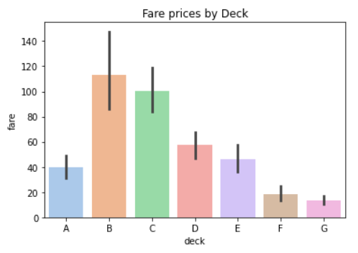
Bar Plot
barplot()
Show point estimates and errors as rectangular bars
You can disable error bars with the option: errorbar=None
You can add bar labels with option: bar_label()
Errorbar의 옵션을 None으로 바꿔보고 bar_label을 추가해보자

Slide 22
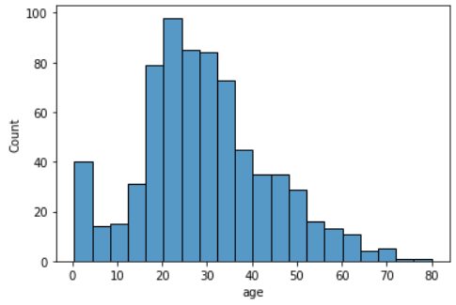
Histogram Plot
histplot()
Univariate or bivariate histograms to show distributions of datasets
sns.histplot(x='age', data = titanic)
Notes:
데이터 세트의 분포를 표시하는 일변량 또는 이변량 히스토그램

Slide 23
Histogram Plot
histplot()
Example of bivariate histograms with title and label names
kde – kernel density estimation
#importing library
import seaborn as sns
import matplotlib.pyplot as plt
#importing dataset
titanic = sns.load_dataset("titanic")
#plotting chart
sns.histplot(x='age', data = titanic, hue='sex', kde = True)
plt.title("Number of Passengers by Age")
plt.xlabel("Age")
plt.ylabel("Number of Passengers")
plt.show()
나이대별 성별 분포

Slide 24
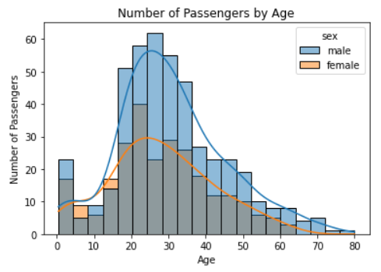
Histogram Plot
histplot()
Example of bivariate histograms with title and label names
kde – kernel density estimation

Slide 25
Histogram Plot
histplot()
Overlapping bars can be hard to visually resolve. A different approach would be to draw polygon
Other options include
element{“bars”, “step”, “poly”}
sns.histplot(x='age',
data = titanic,
hue='sex',
element = 'poly')
Notes:
겹치는 막대는 시각적으로 보기 어령무. 다른 접근 방식은 다각형을 그리는 것

Slide 26
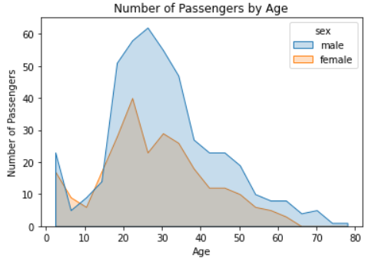
Histogram Plot
histplot()
element = 'poly'
Element 속성 값을 다른 값으로 변경해보자

Slide 27
Distribution Plot
displot()
Shows the univariate or bivariate distribution of data
#importing library
import seaborn as sns
import matplotlib.pyplot as plt
#importing dataset
titanic = sns.load_dataset("titanic")
#plotting chart
sns.displot(titanic, x='age', kind='kde', hue='pclass')
plt.title("Distribution of Passengers by Age")
plt.xlabel("Age")
plt.ylabel("Density")
plt.show()
Notes:
Displot
데이터의 일변량 또는 이변량 분포를 표시합니다.

Slide 28
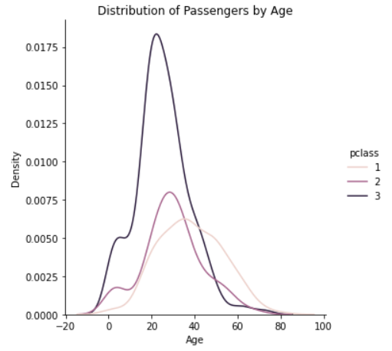
Distribution Plot
displot()
kind includes hist, kde, ecdf
Kind를 다른 값으로 변경해보자

Slide 29
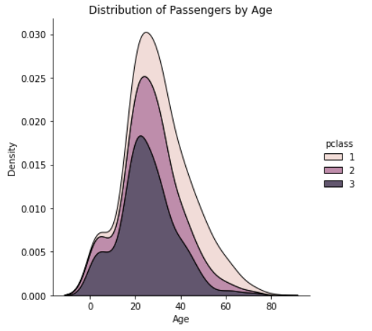
Distribution Plot
displot()
sns.displot(titanic, x='age', kind='kde', hue='pclass', multiple='stack')
Stack 형태로 변경

Slide 30
Facet Grids
FacetGrid()
Multi-plot grid for plotting conditional relationships
#importing library
import seaborn as sns
import matplotlib.pyplot as plt
#importing dataset
titanic = sns.load_dataset("titanic")
#plotting chart
sns.displot(titanic, x='age', kind='kde', hue='pclass')
g = sns.FacetGrid(titanic,
col=“pclass",
row=“survived",
hue='sex')
g.map(sns.kdeplot, "age", shade = True)

Slide 31
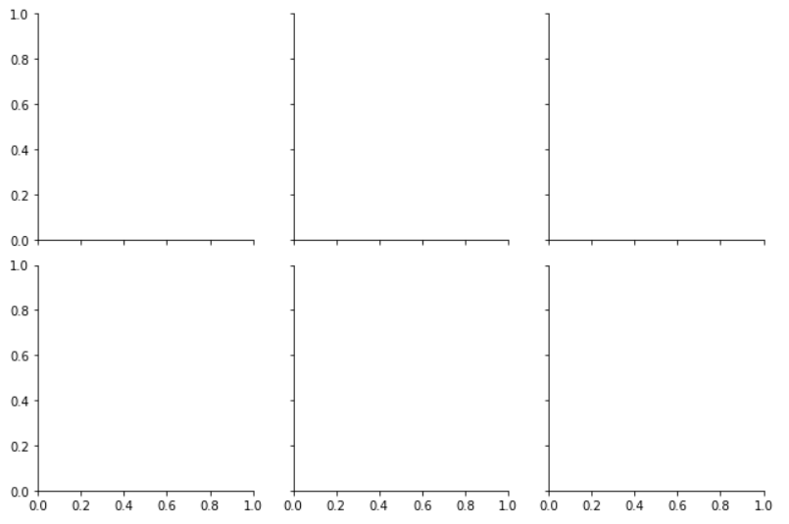
Facet Grids
FacetGrid()
Two steps
Step 1: Create a basic plot with the layout

Slide 32
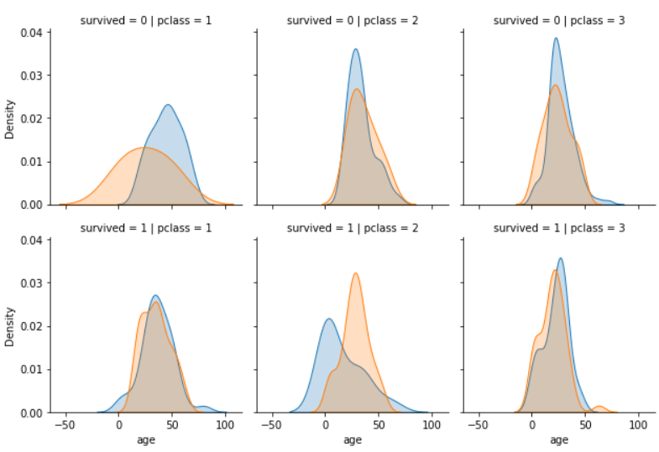
Facet Grids
FacetGrid()
Two steps
Step 2: Use map() function to apply plotting functions

Slide 33
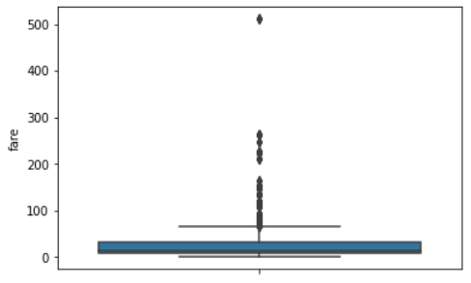
Box Plot
boxplot()
Draw a box plot to show distributions with respect to categories
sns.boxplot(y='fare', data=titanic)

Slide 34
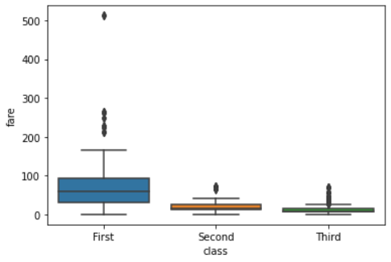
Box Plot
boxplot()
You can create multiple boxes in a single plot
sns.boxplot(x = 'class', y='fare', data=titanic)

Slide 35
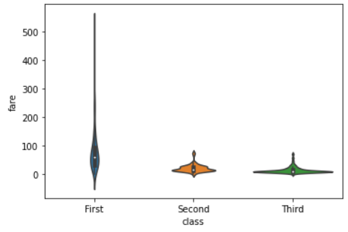
Box Plot
violinplot()
Draw a patch representing a KDE
sns.violinplot(y='fare', x = 'class', data=titanic)

Slide 36
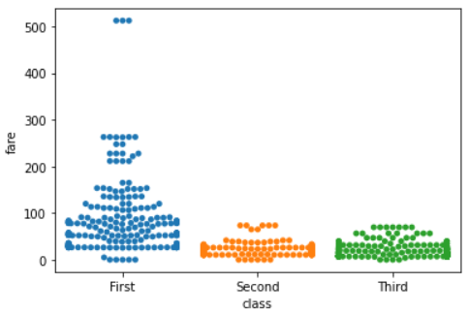
Box Plot
swarmplot()
Draw a categorical scatterplot with points adjusted to be non-overlapping
sns.swarmplot(y='fare', x = 'class', data=titanic)

Slide 37
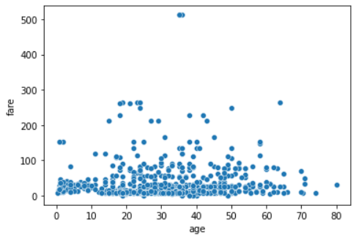
Scatter Plot
scatterplot()
Draw a scatter plot with possibility of several semantic groupings
sns.scatterplot(x='age', y = 'fare', data = titanic)
Notes:
산점도

Slide 38
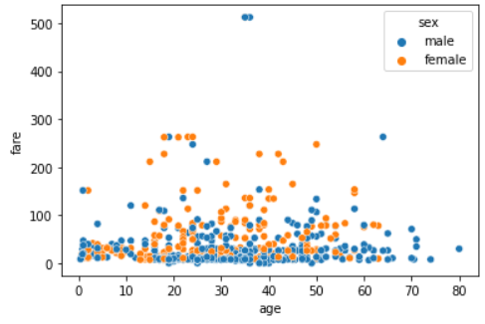
Scatter Plot
scatterplot()
You can include hue option to show different categories in one plot
sns.scatterplot(x='age', y = 'fare', data = titanic, hue = 'sex')

Slide 39
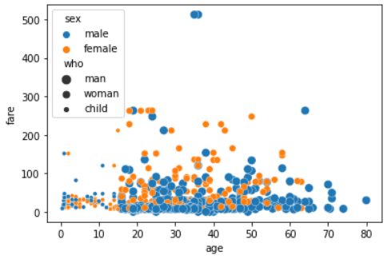
Scatter Plot
scatterplot()
size - variable that will produce points with different sizes
sns.scatterplot(x='age', y = 'fare', data = titanic, hue = 'sex', size = 'who')

Slide 40
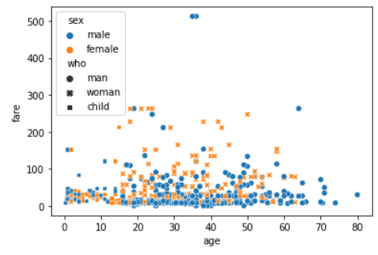
Scatter Plot
scatterplot()
You can change the style of markers
sns.scatterplot(x='age', y = 'fare', data = titanic, hue = 'sex',
style = 'who')

Slide 41
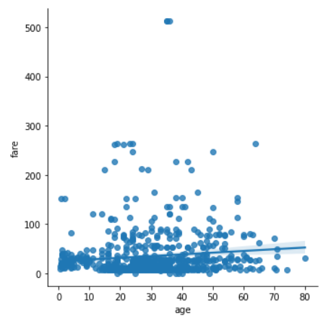
Scatter Plot
lmplot()
Plot data and regression model
sns.lmplot(x='age', y = 'fare', data = titanic)
Notes:
plot data & regression model

Slide 42
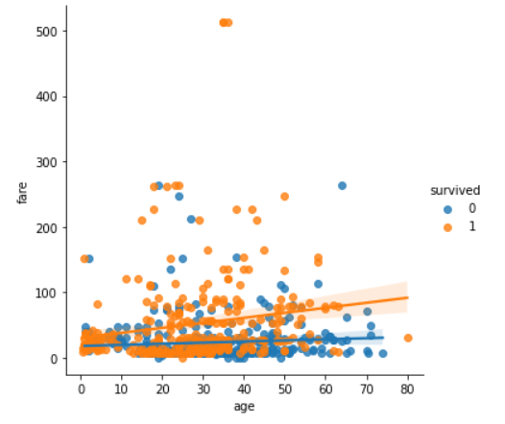
Scatter Plot
lmplot()
You can include hue option to show different categories in one plot
sns.lmplot(x='age', y = 'fare', data = titanic, hue = 'survived')

Slide 43
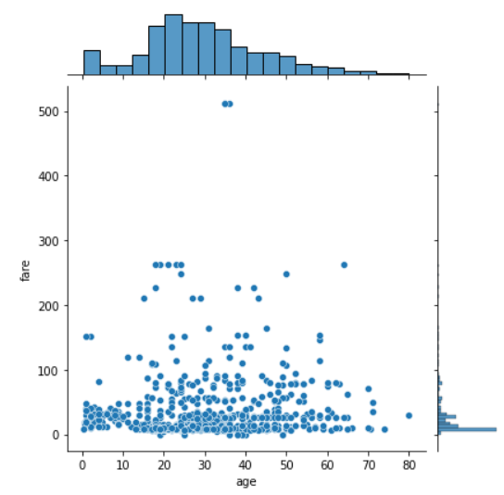
Joint Plot
jointplot()
Draw a plot of two variables with bivariate and univariate graphs
sns.jointplot(x='age', y='fare', data=titanic)

Slide 44
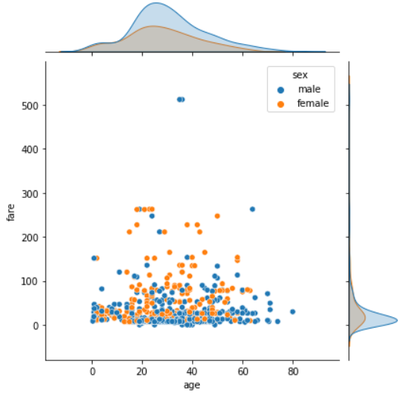
Joint Plot
jointplot()
Draw a plot of two variables with bivariate and univariate graphs
sns.jointplot(x='age', y='fare', data=titanic, hue='sex')

Slide 45
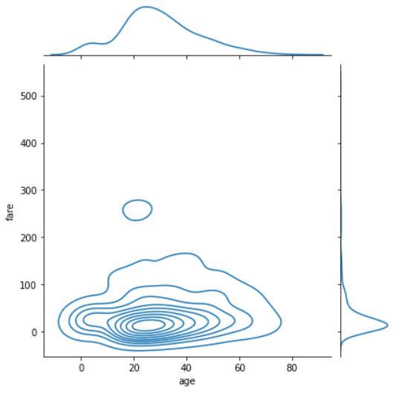
Joint Plot
jointplot()
You can also draw the distribution graph
sns.jointplot(x='age', y='fare', data=titanic, kind="kde")
다른 kind를 적용해보자
Notes:
kernel desity estimate

Slide 46
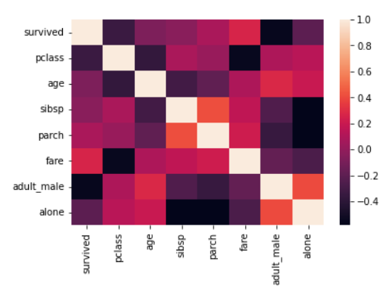
Heat Plot
heatmap()
Plot rectangular data as a color-encoded matrix
titanic_corr = titanic.corr()
sns.heatmap(data = titanic_corr)

Slide 47
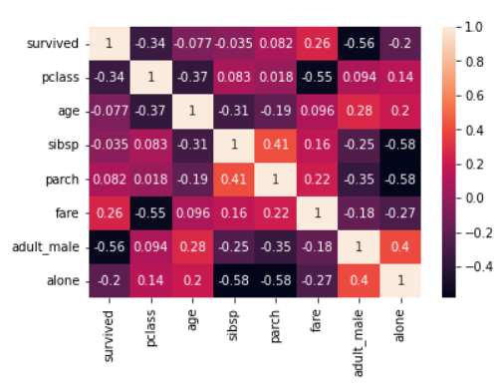
Heat Plot
heatmap()
annot=True to show the labels on the heatmap
titanic_corr = titanic.corr()
sns.heatmap(data = titanic_corr, annot=True)

Slide 48
Homework for Lecture 6
Perform the following
Use on of the dataframes provided by Seaborn
Apply basic charts
Bar and scatter charts
Apply statistical charts
Boxplot, violin and joint plots
Study at least two more by yourself and apply it to the dataset
Add a detailed explanation for each graph

